Slide 1



ICMLDE 2025
International Conference on Machine Learning and Data Engineering
06th-08th November 2025
Dehradun, India
NAKSHATRA
Technical Paper/Poster Presentation Event
TECHNICAL
PAPER PRESENTATION
(IN MICROSOFT POWERPOINT)

Slide 2
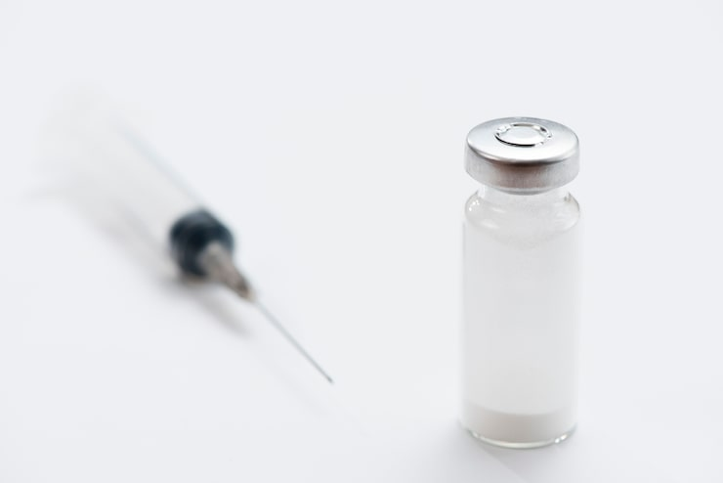
An Explainable Deep Learning Model for Early
Diabetes Detection Using Integrated Attention and Hybrid Loss
Authors: Gayathri P, Tanmay Sharma, Sehaj Kaur Bhatia
School of Computer Science and Engineering, Vellore Institute of Technology, Vellore, India

Slide 3
Introduction
Diabetes mellitus is a chronic metabolic disease that demands early detection to avoid complications.
Classical ML models (SVM, RF, XGBoost) achieve reasonable accuracy but suffer from limited interpretability and dataset bias.
Deep Learning captures complex patterns but often acts as a 'black box.'
Explainable AI (XAI) tools such as SHAP and LIME help decode model reasoning.
This work proposes an explainable DL model that integrates attention and a hybrid loss function for balanced and transparent prediction of early diabetes.

Slide 4
Problem Statement
Diabetes mellitus is a major global health concern that requires early and accurate detection to prevent severe complications. Traditional diagnostic methods are invasive, while machine learning algorithms like SVM and XGBoost, though promising, often act as black boxes. They struggle with data imbalance and limited population diversity, reducing clinical reliability. This study aims to build a deep learning model that combines high accuracy with explainable, symptom-level insights to enable trustworthy diabetes prediction.

Slide 5
Theoretical Background
Explainable AI: SHAP & LIME quantify feature influence for transparent decisions.
ML vs DL Trade-off: ML offers interpretability but lower accuracy; DL offers accuracy but low explainability.
Attention Mechanism: Assigns weights to features based on relevance, mimicking clinical focus.
Hybrid Loss Functions: Combine Focal and BCE to handle class imbalance effectively.
Research Gap: Few existing models unify attention + hybrid loss + explainability within a single DL framework.

Slide 6
Research Gaps
ML models (LR, SVM, KNN, XGBoost) used on PIMA & UC Irvine datasets achieved 75–92% accuracy.
Most faced data imbalance and lacked clinical interpretability.
DL models (CNN, DNN, Attention-DBN) improved accuracy (≈90–98%) but acted as black boxes.
XAI tools like SHAP & LIME were applied post-hoc, not integrated.
Hybrid/ensemble models improved generalization but lacked explainability.
PIMA dataset has limited demographic diversity → poor real-world performance.
Few models combine interpretability, balance handling, and generalization, inspiring our approach.

Slide 7
Methods
Dataset: UC Irvine Early-Stage Diabetes Risk Prediction (521 records).
Features: Age, Gender + 15 binary symptoms (polyuria, obesity etc.).
Pre-processing: Binary encoding (Yes/No→1/0), age normalized [0, 1].
Split: 80/20 train/test (stratified).
Model: Custom DNN with Attention layer + 3 Dense layers (250-250-500).
Regularization: BatchNorm + Dropout (0.4→0.2).
Loss Function: Hybrid (0.6 Focal + 0.4 BCE).
Optimizer: Adam (3 × 10⁻⁴), early stopping on val_AUC.

Slide 8
Model Explainability
Dual XAI integration: Attention Layer + SHAP analysis.
Attention weights highlight important clinical symptoms.
SHAP provides feature-wise explanations for individual patients.
Enables global and local interpretability.
Ensures clinical trust and transparency.

Slide 9
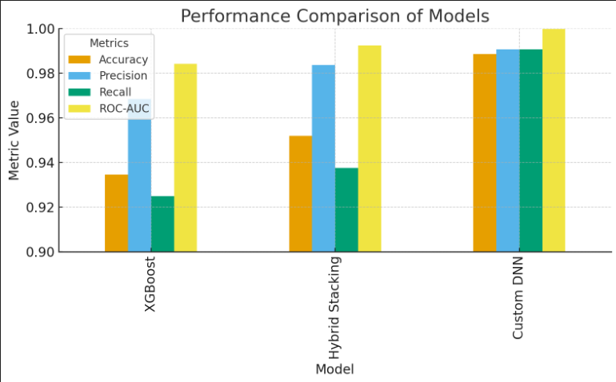
Results and Discussion
Fig. 1. Performance Comparison of Models

Slide 10
Statistical Validation
Outperforms classical and hybrid models.
5-Fold Cross-Validation conducted.
Paired t-tests on AUC:
DNN vs XGBoost → p = 0.0165 (< 0.05)
DNN vs Hybrid Model → p = 0.0353 (< 0.05)
Results confirm the Custom DNN’s superiority is statistically significant.
Demonstrates robust and reproducible performance gain.

Slide 11
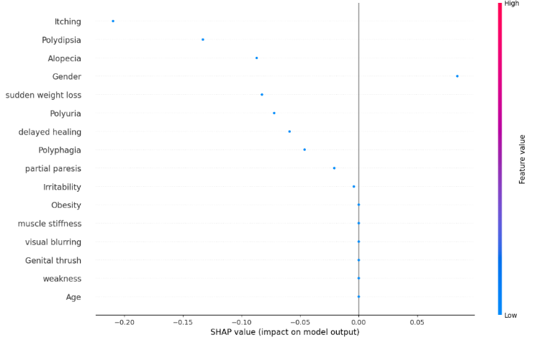
Hybrid Approach Effectiveness
Fig. 2. SHAP summary plot

Slide 12
SHAP ranked polyuria, weight loss, and muscle stiffness as top predictors.
Attention scores align with SHAP, confirming clinically relevant focus.
Global SHAP plots show strong positive impact of polyuria and weight loss, negative from itching.
Local SHAP explains individual predictions and symptom influence.
Dual interpretability (Attention + SHAP) makes the model transparent.
Feature importance visuals validate clinical interpretability and trust.

Slide 13
Conclusion and Future Scope
Custom DNN achieves accuracy ≈ 98.8 % with AUC ≈ 0.9998.
Integrates attention and XAI for transparent predictions.
Validated through statistical testing and clinical consistency.
Future Work:
Working on larger & diverse datasets.
Using multimodal data (genetic, EHR, imaging).
Real-world deployment in healthcare systems.

Slide 14
References
Hasan, R., Dattana, V., Mahmood, S. and Hussain, S., "Towards Transparent Diabetes Prediction: Combining Auto ML and Explainable AI for Improved Clinical Insights," Information, p. 7, 2025.
P. Khokhar, "Towards Transparent and Accurate Diabetes Prediction Using Machine Learning and Explainable AI," Software Engineering Lab., University of Salerno, Italy, Italy, 2022.
Wee, B.F., Sivakumar, S., Lim, K.H., Wong, W.K. and Juwono, F.H., "Diabetes detection based on machine learning and deep learning approaches," Multimedia Tools and Applications, p. 24153–24185, 2024.
H. Naz and S. Ahuja,, "Deep learning approach for diabetes prediction using PIMA Indian dataset," Journal of Diabetes & Metabolic Disorders, p. 391–403, 2020.
O. Olabanjo, "A novel deep learning model for early diabetes risk prediction using attention-enhanced deep belief networks with highly imbalanced data," International Journal of Information Technology (or write Int. J. Inf. Technol.), p. 1933–1955, 2025.
S. Sultana, "Diabetes Prediction using Machine Learning and Explainable AI," North South University, Bangladesh, 2022.
J. Khanam, and S. Foo, , "A comparison of machine learning algorithms for diabetes prediction," ICT Express, p. 432–439, 2021.

Slide 15
14. ‘Thank You’ Slide (1 slide)
Just mention ‘THANK YOU’ on this slide.
Include ‘QUESTIONS?’ If you want.
THANK YOU
Questions?

